Slide 1
Custom Functions for Excel with Azure Functions

Slide 2
Azure Functions
Serverless
Cloud-Only
Event-Driven
Perfect Scalability
Very good fit for Microservices

Slide 3
Azure Cloud Computing
IaaS
PaaS
Infrastructure
VMs
Manage everything yourself
Platform
Shared Platform
Platform manages everything for you
Manage Application Runtime and Application

Slide 4
Azure Cloud Computing
PaaS
FaaS
Platform
Shared Platform
Platform manages everything for you
Manage Application Runtime and Application
Function
Shared Instance
Instance manages everything for you
Function Host manages Runtime and Application
You manage Function only

Slide 5
Azure Functions
DB
Web-Server
Feature
Messaging
Monitoring

Slide 6
Azure Functions
DB
Web-Server
Feature
Messaging
Monitoring

Slide 7

Azure Functions
In Bindings*
Trigger
Out Bindings*

Slide 8


Custom Functions for Excel

Slide 9
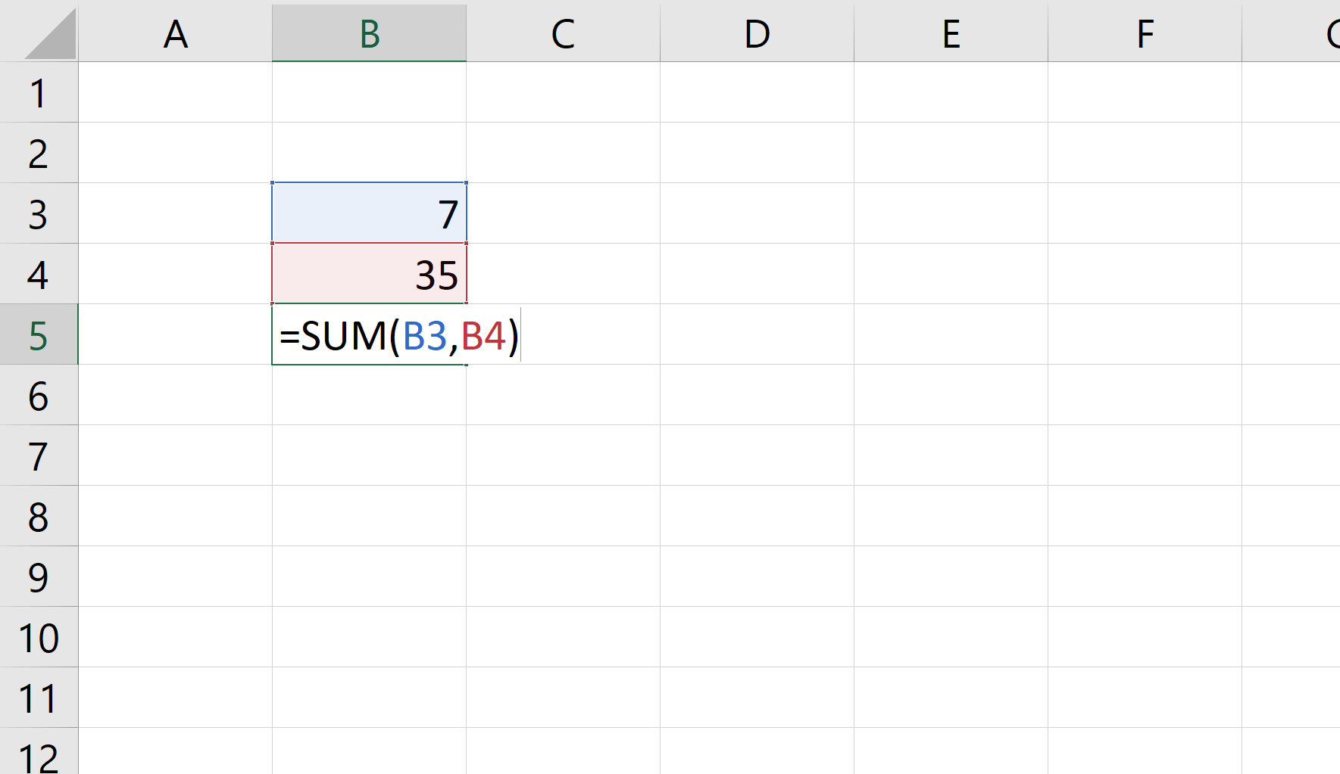

Slide 10
Custom Functions
run across all Excel platforms
run fast
look and feel like native Excel functions
shipped by developers as part of an add-in
make web service calls (if desired)
run offline if they don’t depend on the web
run even when the workbook is unattended (not for preview or first availability)

Slide 11
Custom Functions
Good bye VBA
Hello JavaScript

Slide 12
Custom Functions
VBA
Custom Functions
VB
Runs only on Windows
You need VBA developers
Limited to Macros
JavaScript (TypeScript, F# Dart etc)
Runs everywhere
Grab a Frontend-Dev
Full-feature-set (UI, Control, etc.)

Slide 13
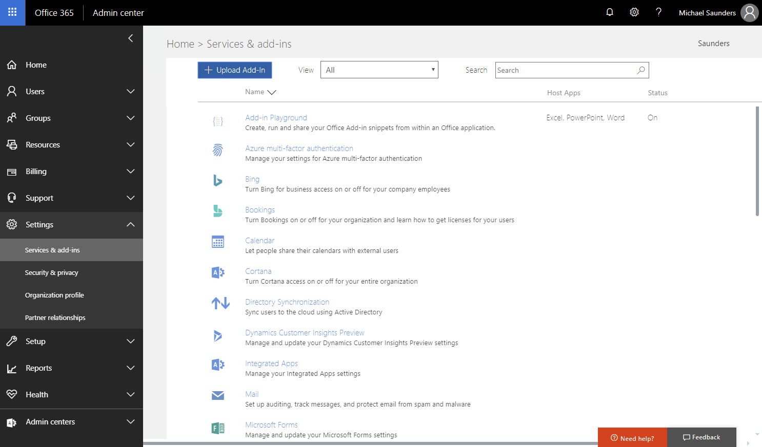
Admin configures access in O365 portal

Slide 14
Where should the code run for custom functions?
Run code on the client
Cheap
Works offline
No network delay
Run code on the server
Scalable for heavy processing and memory needs
Doesn’t depend on a person
Math problems
=ISPRIME
Public Web Data
=BITCOIN
Unattended
=CITYFROMPHONE
Machine Learning
=FRAUDPROBABILITY
JavaScript custom functions
Azure Machine Learning functions

Slide 16
Demo
Custom Functions

Slide 17
Performance
Custom Functions

Slide 18
Details
Intel Xeon E5-1680 v4 @ 3.40GHz (8 cores)
Measured total time for 1000 functions
Median of 20 trials
ChakraCore runtimes are preloaded
Test Scenarios
Calculate the mortgage payment for a given principal, period, and rate
Find the 1000th prime number

Slide 19
Azure Functions Demo
Custom Functions

Slide 20
Custom Functions possible futures
Machine Learning
Push updates
Workflows
Run everywhere

Slide 21
Q & A

Slide 22
Thank you!

